Slide 1
My Alien Encounter
GROUP 2
Alice Baker Elliot Chester Heidi Falcon

Slide 2
The Game
Created to meet the Obscure Sorrows brief. Vellichor and Chrysalism.
Designed for PC with two levels of 2 minutes each.
The aim is to collect the book that describes his first visit.
The games offers simple fun and simple mechanics to a demographic of adults 18- 27 both male and female.

Slide 3
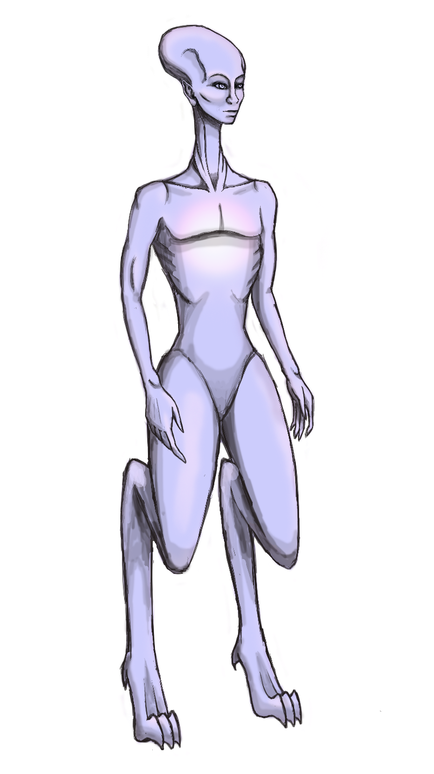
The Alien
The alien feeds on electricity and water makes him weak.
This alien is created human like so it adapts to the environment. It is androgynous.

Slide 4
The Alien’s Environment
The game is inspired on the Victorian era.
There is no electricity in buildings so the darkness adds difficulty to the game.

Slide 5
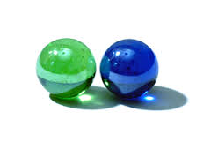
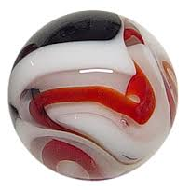
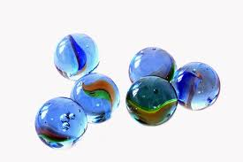
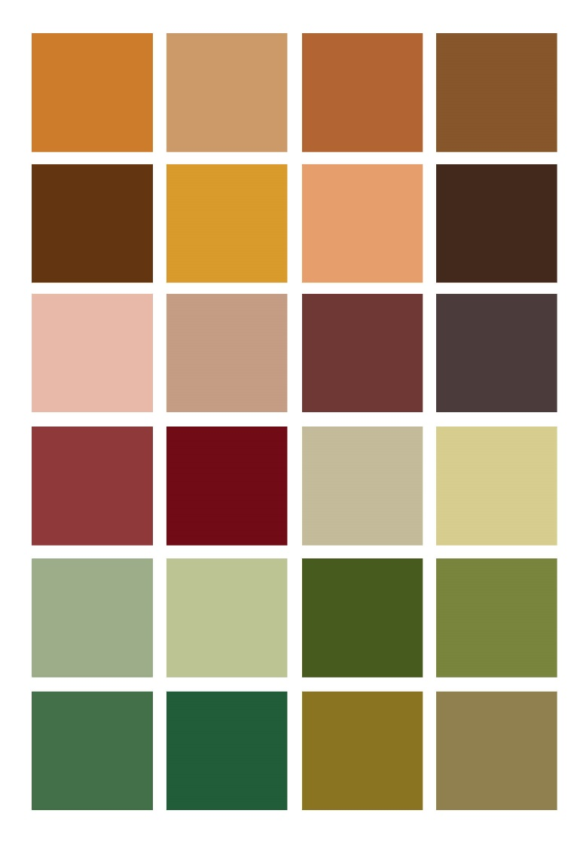
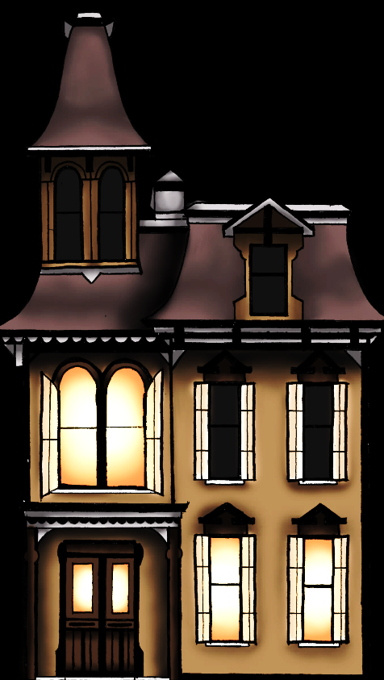
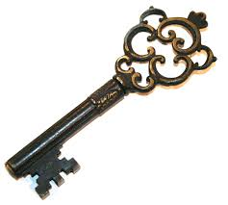
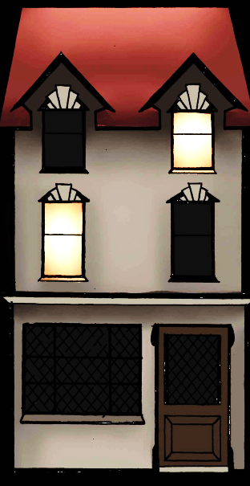


Mood Board

Slide 6
The Mechanics
The game has two levels and the player has 10 lives at the beginning of the game. Each level has an added element of difficulty.
The player will have to think ahead strategically to select the best path forward and progress through levels.
The game ends when the alien finds the book, contacts its spaceship and returns to its planet.

Slide 7
The Game

Slide 8
Suggested Questionnaire
What did you like?
What didn’t you like?
Did you know what to do?
What would you change?
Would you play it again?
Comments:

Slide 9
Any Questions?

